Slide 1
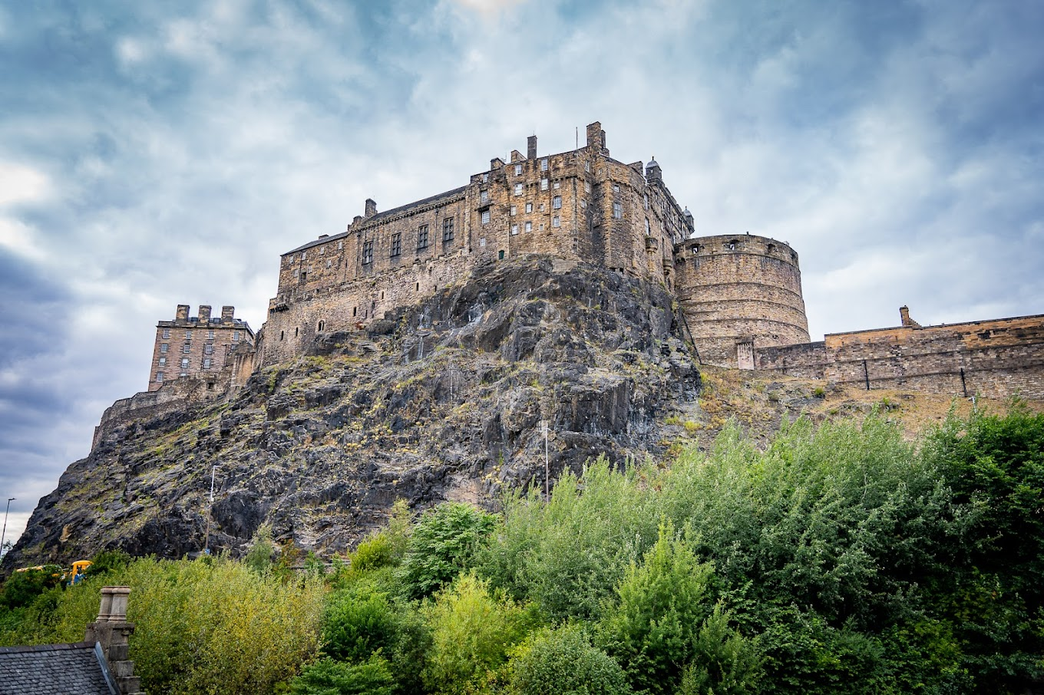



E-Bike Edinburgh
By Ben de Sousa, Alexandros Zachakos, Nolan Willoughby, and Todd House
Notes:
Person 1 does slides 1-4. person 2 does 5-6, #3 does 7-8, #4 9-11

Slide 2
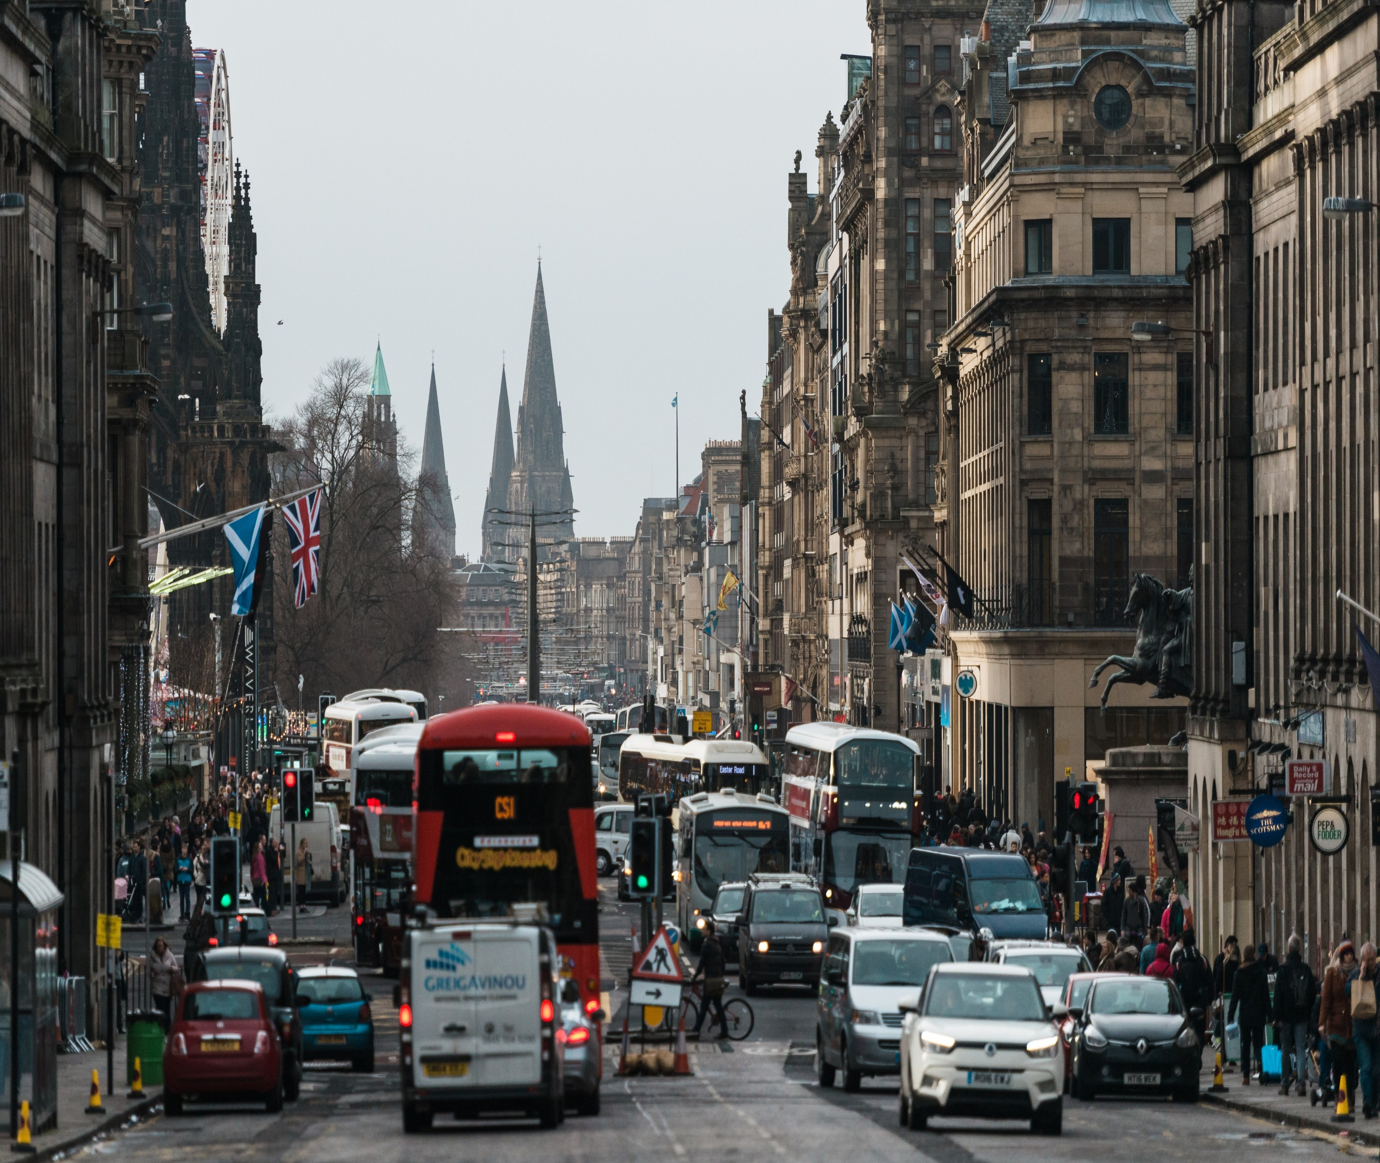

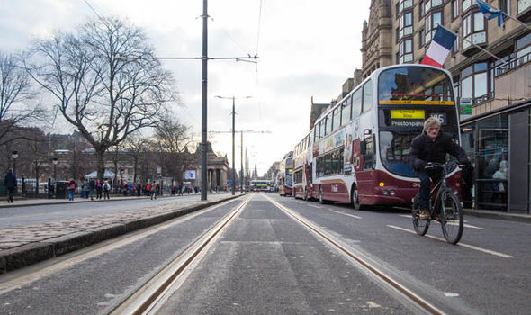
The Problem
High Traffic
Reliance on Fossil Fuels
City Air Quality / Citizen Health

Slide 3
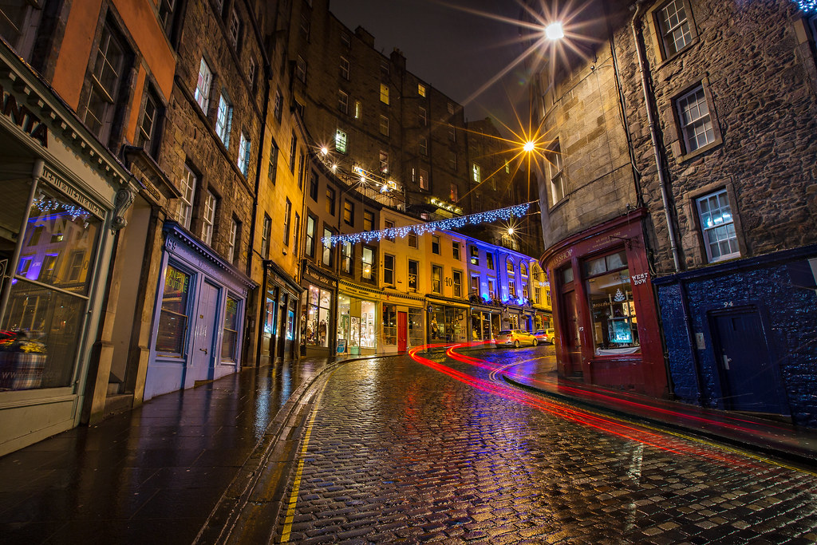

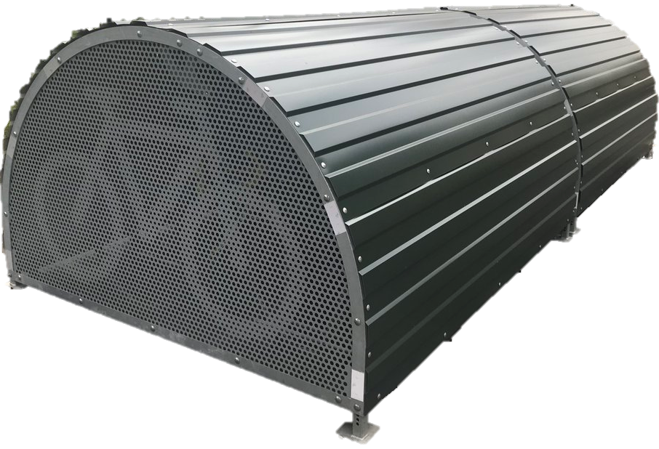
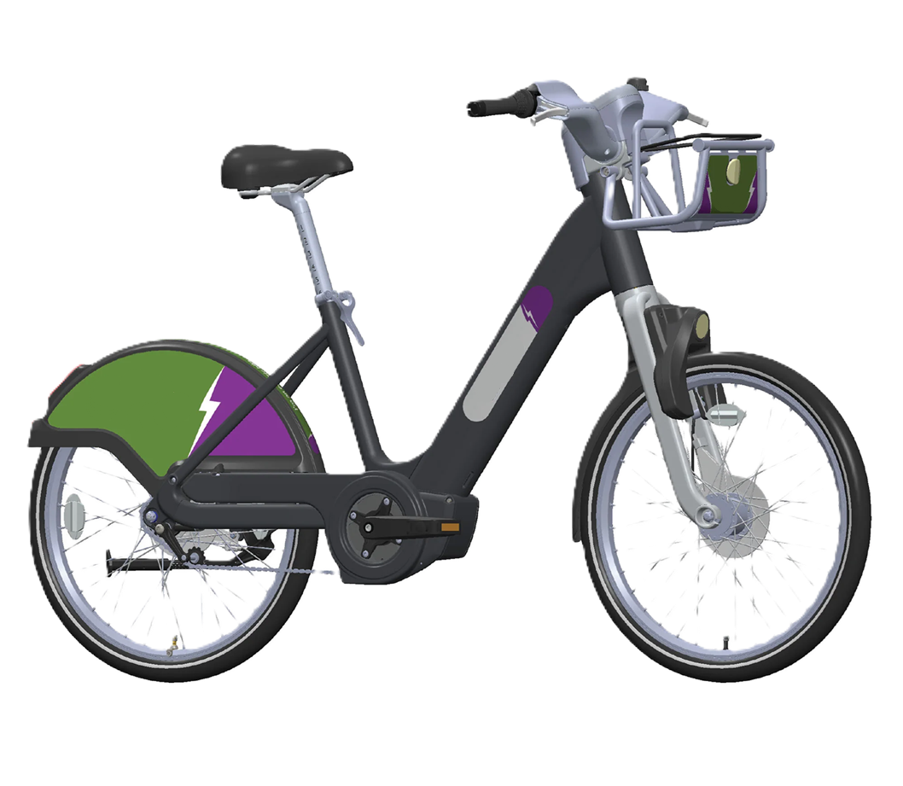
The Solution
E-Bike hire scheme
Less cars - more bikes
Healthy, happy citizens
Notes:
Traffic accidents, CO2 emissions, noise pollution, light pollution. Happiest countries have higher intracity cycling. Denmark #2 in happiness, 90% bike ownership, notably, cycling accounts for 21% of trips under 10 kilometres and 15% of all trips in Denmark, showcasing its versatility as a mode of transport. https://roadandmountainbikereviews.co.uk/25-striking-cycling-statistics-in-denmark/

Slide 4
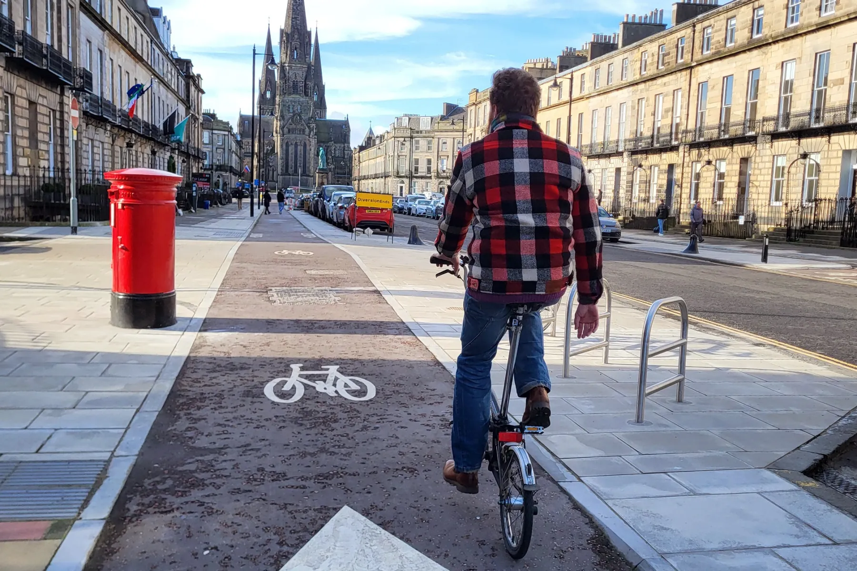



ENVIRONMENT
E
GOVERNANCE
Reduce Traffic
Fuel
Rubbish
SOCIAL
Infrastructure Damage
Council Investment¹
Industry Investment
Employee Benefits
Value Proposition
S
Bike Availability
Distance to Dock
Usage Cost
Dock Availability
POI Coverage
G
Notes:
https://democracy.edinburgh.gov.uk/documents/s82577/8.1%20-%20Roads%20and%20Infrastructure%20Investment%20-%20Capital%20Delivery%20Priorities%202025_26.pdf
The Roads and Infrastructure Investment Programme for 2025/26 proposes the capital budget of £25.686m should be allocated across six different work streams: carriageways and footways; street lighting and traffic signals; road structures; other asset management; road operations and miscellaneous. The carriageway and footways work accounts for £18.161m or 71% of the available funding

Slide 5
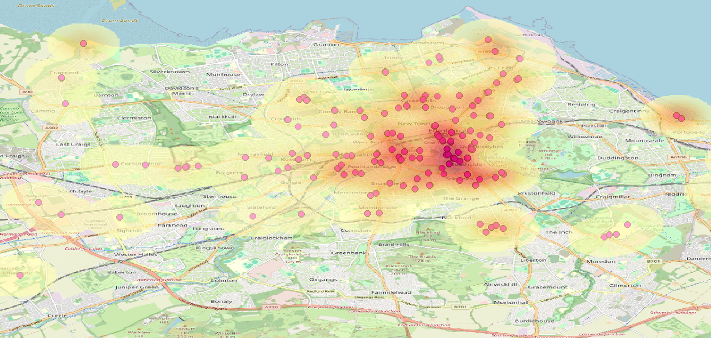

Underlying Magic
This slide will be giving a breakdown of 2-4 graphics defining our behind the scenes of our modelling
Notes:
Cluster graphic, talk about assumptions made in solution formulation, POI weighting, etc

Slide 6
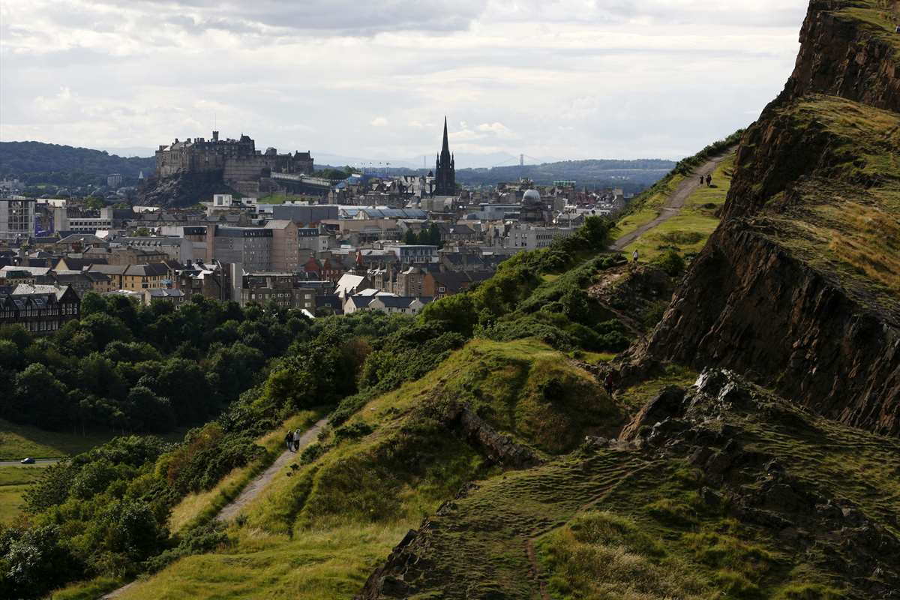
Outputs
Station locations
Bikes per station
Coverage
Scores?

Slide 7
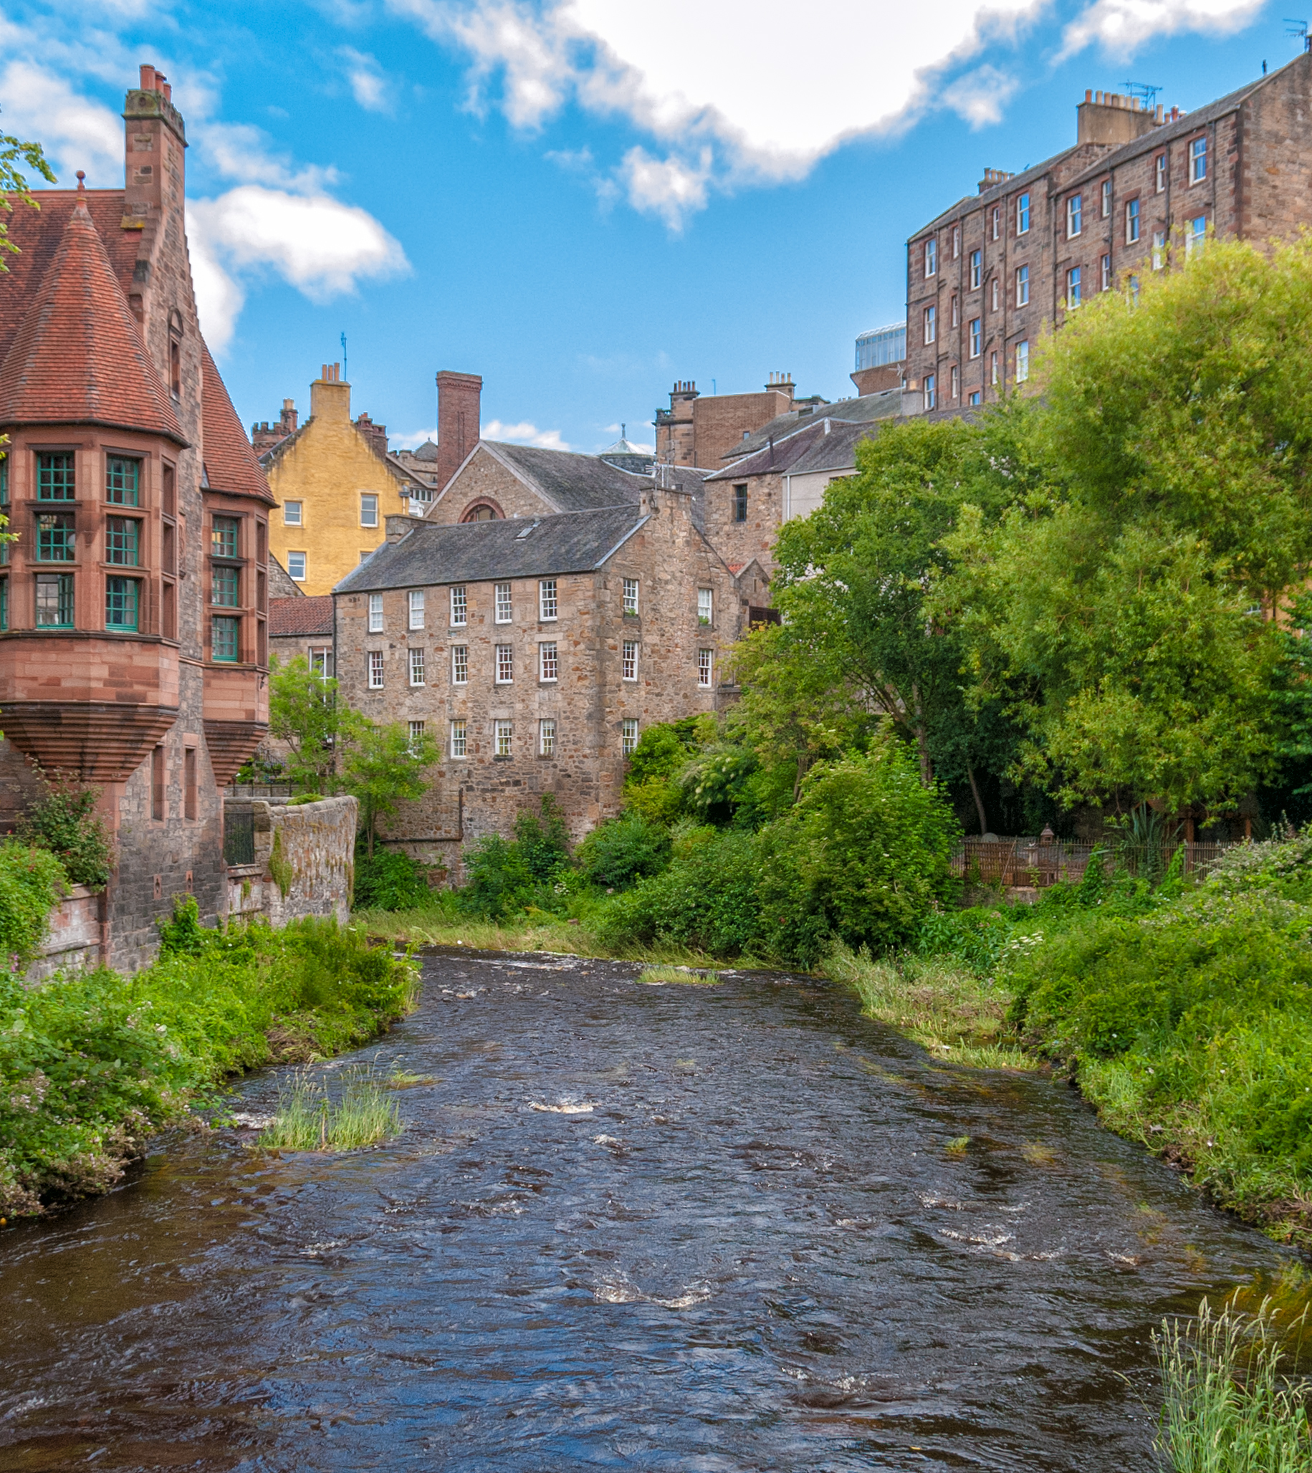
Financial Projections
and Key Metrics
Budget:
Fixed Startup Costs
Cost per user
Recoup time

Slide 8




SWOT
Cover X% of POIs
Hangar Docking
Modular modelling
Branding Partnerships
Bike Lane Analysis
Maintenance Activities
STRENGTHS
OPPORTUNITIES
S
W
O
T
WEAKNESSES
THREATS
Relies on Assumptions
Data basis
Cost
Lothian Buses
VOI Bike Scheme
Vandalism

Slide 9

Maintain,
Sustain,
Gain
Success
Demand
User
Satisfaction
Availability
& Quality
Maintenance
Notes:
Maintenance is key to the scheme
Planning/forecasting tool/dashboard
Community incentives

Slide 10
Current Status,
Accomplishments,
Timeline, and Use of Funds
Timeline analysis? Sensitivity analysis?
Briefly elaborate on what you want to discuss.
Briefly elaborate on what you want to discuss.

Slide 11

Questions?

